Slide 1
Literature 2
Revision Pack
Work through the activities here to help you be able to address this question.
How does the writers present family relationships within ‘Love and Relationships’?
Work through activities on these poems to
write about two of these
This is the question you will be answering before you leave today.

Slide 2
Warm up
What poems can you remember from your Anthology which focus on family. Summarise what they tell us about families –
_______________________ - _______________________________
_______________________ - _______________________________
______________________ - ________________________________
______________________ - ________________________________
______________________ - _________________________________

Slide 3
Eden Rock
Underline any words / phrases you think are important

Slide 4
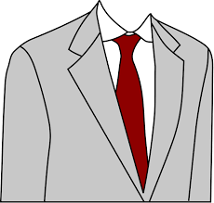
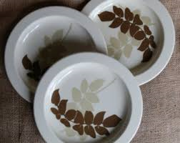
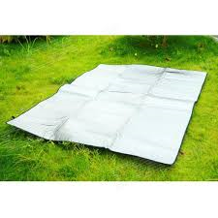
How would you match these pictures to this poem?

Slide 5
‘Eden Rock’ - Structure
What does the word ‘Eden’ suggest about the memory?
___________________________________________________
What does the ‘rock’ show about his relationship with parents?
____________________________________________________
Why is there a consistent structure when retelling memory of time with parents?
________________________________________________________
Why does the structure change? What show about relationship?
________________________________________________________

Slide 6
‘Eden Rock’ – Language
Which words show the consistency he associates with his parents?
___________________________________________________
How is his mother shown in an angelic way?
____________________________________________________
Why?
_____________________________________________________
How does the writer use images to create unity between the family?
________________________________________________________

Slide 7
‘Eden Rock’ – Language
What small + insignificant adjectives are used?
____________________________________________________
Why does the writer use these?
_____________________________________________________
Why does the poem change?
____________________________________________________
What verb shows there is still a bond despite physical separation?
______________________________________________________

Slide 8
Follower
Underline any words / phrases you think are important
My father worked with a horse-plough,
His shoulders globed like a full sail strung
Between the shafts and the furrow.
The horse strained at his clicking tongue.
An expert. He would set the wing
And fit the bright steel-pointed sock.
The sod rolled over without breaking.
At the headrig, with a single pluck
Of reins, the sweating team turned round
And back into the land. His eye
Narrowed and angled at the ground,
Mapping the furrow exactly.
I stumbled in his hob-nailed wake,
Fell sometimes on the polished sod;
Sometimes he rode me on his back
Dipping and rising to his plod.
I wanted to grow up and plough,
To close one eye, stiffen my arm.
All I ever did was follow
In his broad shadow round the farm.
I was a nuisance, tripping, falling,
Yapping always. But today
It is my father who keeps stumbling
Behind me, and will not go away.

Slide 9
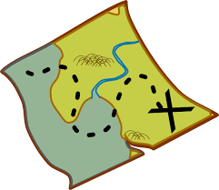
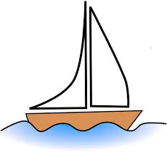
How would you match these pictures to this poem?

Slide 10
‘Follower’ – structure
What does the title suggest about the relationship between Father + Son?
_______________________________________________________
How does the stanza structure + rhyme scheme show the passing of time?
_______________________________________________________
How do we see a role reversal as time passes?
________________________________________________________

Slide 11
‘Follower’ – Language
Find 2 examples of sailing imagery –
___________________________
__________________________
How does this link to the Father’s control?
________________________________________________________
Why are we told his shoulders ‘globed’?
_______________________________________________________
Which words show he is fully in control + aware of what he is doing?
_________________________________________________________

Slide 12
‘Follower’ – Language
How do we know the son admired his Father?
______________________________________________________
Which verbs are used to show the lack of control in the son?
_______________________________________________________
Find the use of caesura to show how quickly time seems to pass?
_____________________________________________________
Which verb is repeated? - __________________________
Why is this repeated? - ____________________________________

Slide 13
Walking Away
Underline any words / phrases you think are important
It is eighteen years ago, almost to the day –
A sunny day with leaves just turning,
The touch-lines new-ruled – since I watched you play
Your first game of football, then, like a satellite
Wrenched from its orbit, go drifting away
Behind a scatter of boys. I can see
You walking away from me towards the school
With the pathos of a half-fledged thing set free
Into a wilderness, the gait of one
Who finds no path where the path should be.
That hesitant figure, eddying away
Like a winged seed loosened from its parent stem,
Has something I never quite grasp to convey
About nature’s give-and-take – the small, the scorching
Ordeals which fire one’s irresolute clay.
I have had worse partings, but none that so
Gnaws at my mind still. Perhaps it is roughly
Saying what God alone could perfectly show –
How selfhood begins with a walking away,
And love is proved in the letting go.

Slide 14
How would you match these pictures to this poem?

Slide 15
‘Walking Away’ Structure
What does the title foreshadow about the poem?
_____________________________________________________
We see one line is used repeatedly in each stanza – what does this show about the strength of the father’s love?
______________________________________________________
How does the structure represent the passing of time?
_____________________________________________________
How does the father’s emotions change as the poem progresses?
_______________________________________________________

Slide 16
‘Walking Away’ – Language
How are the seasons used symbolically at the beginning? _______________________________________________________
Why does it use example of him ‘watching’ him play football – how does this also foreshadow what will happen?
_______________________________________________________
What simile is used? -_____________________________________
What does this show? _____________________________________
What verb is used to show the pain felt here? ___________________

Slide 17
‘Walking Away’ – Language
What metaphor shows he doesn’t feel his son is ready in stanza 2?
_______________________________________________________
What adjective is used to show this in stanza 3? _________________
How is another simile used? __________________________
Which word shows he is finding separation easier? _____________
Which word in last stanza shows he can still feel the emotions?
____________________________________________________
How is religious imagery used at the end?
____________________________________________________

Slide 18
Getting ready for the exams
You can use the notes from this booklet to help you
Fill in 2 poems which you are going to use from these 3.
How does the writer show a family relationship in ________________________________ and _______________________________________?
It is easy to answer questions – answering the exam question is the hard part.
Can you apply your knowledge?

Slide 19
Write up your intro
__________________ shows a strong family relationship because ……………………………………………………………………………………………………….
We also see this in _____________________________ as ………………..
…………………………………………………………………………………………………….
Both poets show …………………………………………………………………..
Write this up in the exam paper at the back of the booklet

Slide 20
Structure
Your next paragraph is bringing how the poem has been structured. Again, move between the 2 poems – alternate point on each.
Structural feature – what this shows
Both writers use their structure to convey the loving family relationships. We see this through the titles. In ‘________________________’, we learn that ………………………………………and in ‘______________________’ this …………………………………………………………………………………….
Look at role reversal / rhyme scheme / stanza structures
Both poems have displayed their ………………………………. through…………..

Slide 21
Language
You now need to look at as many quotes as you can to say what method is used + what we learn from them. Again, move between the poems. USE YOUR NOTES TO HELP
The writers also use their language features to show ……………………
The writer uses …………………
This conveys ………………….
Another method used is ……………………………………..
The writer uses this to demonstrate …………………………..
A further example is …………………………….. which shows ………………….

Slide 22
Ending the essay
Look back at the intro
You just answered the question here – do the same again at the end to just say how each poem linked to the question.
Write a brief conclusion to wrap this up

Slide 23
Finishing checks
Make sure every time you say ‘This’ – it MUST be at the start of a new sentence.
The title of the poem needs to have quote marks + capital letters.
Watch your sentence length.
Have you moved between the poems rather than all one?

