Slide 1
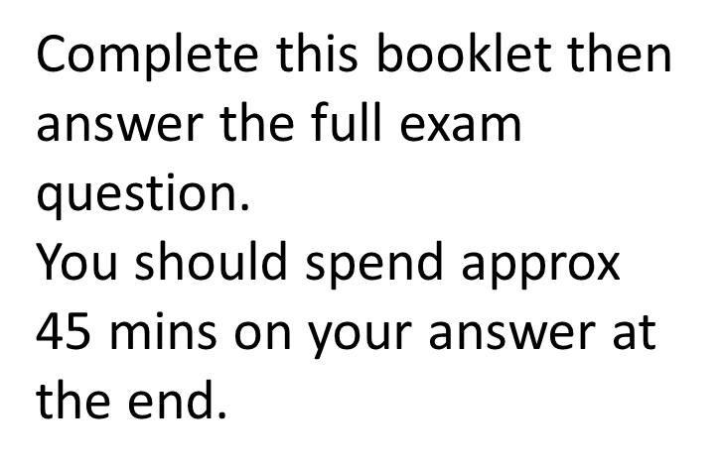
Literature Preparation Pack
Paper 2 – 2 hr 15 mins = 60%
Section A – An Inspector Calls = 45 mins
Section B – Poetry Anthology – Love and Relationships – 45 mins
Section C – Unseen Poetry – 45 mins
An Inspector Calls
Don’t forget to use your Revision Guide to help you if stuck!

Slide 2
Lighting
________________________________________________________________________________________________________________________________________________________________________________________________________________________________________________
________________________________________________________________________
Why does it start ‘pink and intimate’?
Why does it get brighter and harder?
Who does the light change have the biggest impact on?

Slide 3
Setting
Where is the whole play set?
What does this show us about the family’s attitude?
How can you link this to change?

Slide 4
Entrances + Exits
What is significant about the arrival of the Inspector?
What is important about the fact the females are not present for arrival of Inspector?
What is important about Gerald and Eric’s exits?

Slide 5
Structure
Who controls the structure of the interrogations?
Why do we have older generation questioned followed by younger eg Mr B / Sheila ……. Mrs B / Eric?
Why is Gerald’s interrogations structured between these?

Slide 6
Engagement ring
How does Sheila and Mrs B react towards this?
How did Mr B respond to this?
Why was it significant that Sheila gave it back – link this to role of women?
What does the ring represent at the end?

Slide 7
Inspector
How does Mr and Mrs B try to intimidate him?
Who’s voice does he represent?
Who does he have the greatest impact on?
What language features does Priestley use in the Inspector’s final message?

Slide 8
Eva Smith
Which class does she represent?
How do the men eg Eric and Gerald treat her?
How does the older generation treat her?
Who contrasts her?
What do we learn about her character / personality?

Slide 9
What can you say about this quote?
‘Crofts and Birlings are ____________________
together …. For ____________________________________________________________________’
Mr _____________

Slide 10
What can you say about this quote?
‘These ________ aren’t _______________________ - they’re _______________’
_____________

Slide 11
What can you say about this quote?
‘You’re just the kind of son- ______________ I’ve _____________________________________________’
________________

Slide 12
What can you say about this quote?
‘My G________!’
‘How ___________!’
_______ and __________

Slide 13
What can you say about this quote?
‘He _____________’
________________

Slide 14
What can you say about this quote?
‘You mustn’t _______________ a kind of _________ between _____________________________________________’
________________

Slide 15
What can you say about this quote?
‘There are ______________________________________________of ______________________________ still left with us’
________________

Slide 16
What can you say about this quote?
‘they will be taught it in _____________________________________________’
________________

Slide 17
What can you say about this quote?
‘We don’t ______________
We are ________________
We are r_______________’
________________

Slide 18
What can you say about this quote?
‘You’re not the _______________ a chap can ____________________________________________’
‘You __________ her - _________ you, ___________’
________________

Slide 19
What can you say about this quote?
‘We’ve been ________’
‘There’s every ex________ for what we did’.
________________

Slide 20
Essay snapshot - Inspector
Summarise your paragraph down to one line.
Para Topic
Why does he enter when he does?
How the older generation respond to him
How the younger generation respond to him
How he links to Eva
Speeches at the end Devices in these!
Structure + staging

Slide 21
Essay snapshot – Mr Birling
Summarise your paragraph down to one line.
Para Topic
Start – how behave at start?
Respond to others at start
Treat Eva + react to death
Respond to Inspector
End when Inspector leaves
Structure + staging

Slide 22
Essay snapshot – Mrs Birling
Summarise your paragraph down to one line.
Para Topic
Start – how behave at start?
Respond to others at start
Treat Eva + react to death
Respond to Inspector
End when Inspector leaves
Structure + staging

Slide 23
Essay snapshot – Sheila Birling
Summarise your paragraph down to one line.
Para Topic
Start – how behave at start?
Respond to others at start
Treat Eva + react to death
Respond to Inspector
End when Inspector leaves
Structure + staging

Slide 24
Essay snapshot – Eric Birling
Summarise your paragraph down to one line.
Para Topic
Start – how behave at start?
Respond to others at start
Treat Eva + react to death
Respond to Inspector
End when Inspector leaves
Structure + staging

Slide 25
Essay snapshot – Gerald Croft
Summarise your paragraph down to one line.
Para Topic
Start – how behave at start?
Respond to others at start
Treat Eva + react to death
Respond to Inspector
End when Inspector leaves
Structure + staging

Slide 26
Methods used
Why is the names important?
Eva Smith - _______________________________
Daisy Renton - _____________________________
Inspector Goole - _________________________
Why does Mr Birling repeat ‘hard headed business man?’
_______________________________________________________________________________________
Why does Priestley use dramatic irony on Mr Birling’s predictions?
_______________________________________________________________________________________
How do we see a role reversal created between the generations?
_______________________________________________________________________________________
How do we see a cyclical structure?
_______________________________________________________________________________________
Why is this important?
_______________________________________________________________________________________

Slide 27
Your task
You now have an essay plan for every character.
Who do you think you would find the most difficult to write up?
___________________________
This is who you are going to complete your essay on.

Slide 28
Here to help
Priestley shows us that …..
Priestley conveys the Inspector …….
We can see that ……..
Priestley portrays …….
This shows…….
From this the audience learn…..
We can see that ………….
This conveys ………..
……. which demonstrates
Writer’s methods
Contrast
Mouth piece
Role reversal
Dramatic irony
Repetition
Inclusive pronouns
Structure
Staging

