Slide 1
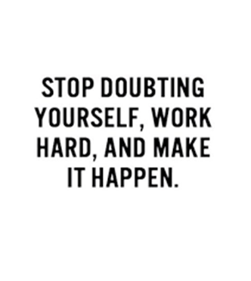
What do we learn about Mr Birling in An Inspector Calls?
Write about
How Mr Birling responds to his family and the Inspector
How Priestley presents Mr Birling by the way he writes
Literature Workbook
Work through the activities here to help you be able to address this question.
This is the question you will be answering before you leave today.

Slide 2
Task 1
Write out 5 key points which you remember about Mr Birling from the play.
1- __________________________________________
2-__________________________________________
3-___________________________________________
4-___________________________________________
5-___________________________________________

Slide 3
Task2 - Match these words with the meaning
Narcissistic
Stubborn
Patronising
Dramatic irony
Condescending
intimidating
Remorseless
Only thinks about himself
Audience have a greater awareness than character
Refuses to listen to others
Is not sorry for his actions
Thinks he is better than others
Uses his power to threaten
Speaking down to someone

Slide 4
Task 3- These are the quotes which you need to get into your essay. Complete the missing words from these
Pg 4- You’re just the kind of __________ I’ve always __________
Pg 4 - Crofts and Birling are working _____________ – for ______ costs and higher _________
Pg 6 - Hard headed ______________ business ___________
Pg 7 -Peace and ______________ and rapid ___________ everywhere
Pg 8 - As long as we __________ ourselves…. Don’t start a _____________

Slide 5
Pg 9 –A __________ has to make his _____________
Pg 10 -Community and all that ____________
Pg 14 – Still I can’t _____________ any __________________
Pg 15 - It’s my ________ to keep labour _____________
Pg 54 - ‘you’re not the ___________ a chap could go to when he’s in ________________
Pg 56 - ‘I’d give ______________.’
Pg 68 – the whole ____________ thing can have been a piece of _________’

Slide 6
Task 4 - Quick fire questions
What drink does he buy to impress Gerald? ______________________
List two predictions which show he is not as knowledge as he believes?
1 -____________________________ 2 - ____________________________
What is Mr Birling hoping to be awarded? __________________________
What sport does he say he plays to show the Inspector he is well connected?
________________________________
Why does Mr Birling keep telling Sheila to leave?
___________________________________________________
What is Mr Birling most concerned with regarding Eric at the end?
___________________________________________________
What call does Mr Birling take at the end?
_________________________________________________

Slide 7
Task 5 - Structure
Why does Mr Birling say the very first line of the play – what does this show us about him?
______________________________________________________
Why do you think the Inspector questions him first – what does this show about his role in the family?
______________________________________________________
Who is interrogated after Mr Birling – why is there a contrast here?
_____________________________________________________
Why do you think Mr Birling has the last line – what does this remind us about his attitude? (what has he not done? )
_______________________________________________________

Slide 8
Staging
What happens to the lighting the play?
______________________________________________________
How is this ironic for Mr Birling?
_____________________________________________________
There is only one set – the family’s dining room + this does not change.
How does this link to Mr Birling’s mindset?
_____________________________________________________

Slide 9
Task 6 – methods!!!
It is key you use these words in your answer!
What is the method when
Mr Birling thinks he knows more than he does – d_________ i______
Saying ‘hard-headed business man’ more than once – r__________
Speaking more than others – l_________ of t_______
When Eric answers back to him – Ques___________
When Eric and Sheila’s views are different – c_____________
When younger generation try teach him – r______ r____________

Slide 10
Task 7 - Context
How do we know Mr Birling is a CAPITALIST not a SOCIALIST?
________________________________________________________________________________________________________________________________________________________________________
Where does Mr Birling want to be on the social hierarchy?
_______________________________________________________
How does Mr Birling treat people lower than him on the social hierarchy?
_______________________________________________________
How do we know that Mr Birling is not as high on the social hierarchy as his wife?
____________________________________________________________

Slide 11
Your question
Before you start you have to decide your topic sentences for your essay – the points you want to cover.
These are the paragraphs you are going to write for this
Para 1 – How he acts at the beginning
Para 2 – How acts to others – (Contrast Eric/Gerald/Sheila)
Para 3 – How treated Eva – views on lower class
Para 4 – How responded to Inspector
Para 5 – How act at the end (Inspector leave)
Para 6 – Structure + staging
Go through our quotes slides and label which paragraph you think you should use each quote in.

Slide 12
Sentence starters
We see that
Priestley demonstrates
The audience learn
The audience can see
From this we learn
This conveys
This shows
From this we can see that

Slide 13
Getting started
Show his lack of change!
You always start with a SHORT answer to the question
Priestley presents Mr Birling as a wealthy business man who is too stubborn to admit the lessons the Inspector arrives to teach. He remains a strong capitalist who refuses to change his attitude.
Start with writer’s name
Mention this to show you know!

Slide 14
Getting started – Para 1 - end
Use each of these plans to write up the next paragraph.
Remember to use all of the information from this booklet to help you.
The first way we see Mr Birling presented is through his attitude at the beginning of the play.
Impress Gerald
Impact of dramatic irony
Capitalistic views + how he views socialists
How he portrays himself as dominant character

Slide 15
Para 2 –others
Use each of these plans to write up the next paragraph.
Remember to use all of the information from this booklet to help you.
The next way Priestley is presented is through how he treats the younger generation.
Isolate Eric
Contrast treatment to Gerald – more accepting to him – why?
Sheila – protective as woman

Slide 16
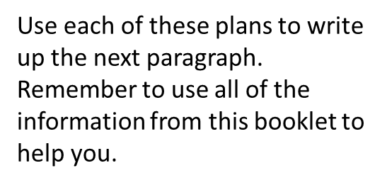
Para 3 – Eva
The way in which Mr Birling treated Eva reveals a great deal about his character. It is ironic that Mr Birling fired Eva for wanting more money which is exactly …………………………………………
How did he treat her + his workers?
How does he feel about her death?
Whose reactions could you contrast his with?

Slide 17
Para 4 – The Inspector
Priestley uses the character of the Inspector to demonstrate Mr Birling’s character further.
How does Mr Birling react towards the Inspector?
Why?
What does he say to him?
What does this show about him?
Listen to message or not?

Slide 18
Para 5 – end
The final way Mr Birling’s character is presented is through the way he acts when the Inspector leaves.
What does he offer to give before he leaves – what does this show?
What does he do with the news from Gerald?
Who can we contrast him with at this stage?
What is significant about the very ending?

Slide 19
Para 6 – Structure and staging
Priestley uses the structure and staging to highlight Mr Birling’s character.
Why open + close with him?
Impact of cyclical structure
Contrast with Sheila after him
Use of lighting – why ironic get brighter?
Use of single set – what show about his viewpoint?

Slide 20
Ending your piece
Like the beginning, end with a few lines which show a full answer to the question.
Priestley has demonstrated that Mr Birling has remained unchanged by the visit from the Inspector. Despite his warning, Mr Birling is still fixated on the impact this will have on him rather than take any responsibility for death of Eva and the lower class or his work force who she represents.

Slide 21
Before you finish
Make sure EVERY time you use a character’s name it has a capital letter.
Check that you have examples from the play.
Have you said what we learn?
Each paragraph needs to have a clear opening + closing line

