Slide 1
‘‘Fair is ______ and foul is _____’

Slide 2
_______ Macbeth
V_______ cousin!
W______ gentleman!

Slide 3
Stars, hide your ________, let not light see my ________ and deep desires’

Slide 4
‘That is ______ on which I must __________’.

Slide 5
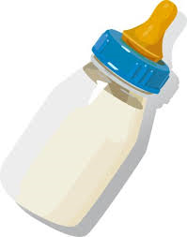
‘come to my woman’s __________ and take my _______ for _________’

Slide 6
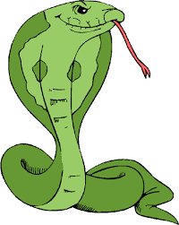
‘look like th’inno_________ __________ but be the _____________ under’t’

Slide 7
Verbs!
‘I would, while it was __________ … have __________ my nipple from his boneless gums and _________ the brains out’.

Slide 8
‘We still have j_________ here’.

Slide 9
‘We will p______ no further in this b_______’

Slide 10
‘My ___________ are of your colour, but I shame to wear a _________ so w_______’

Slide 11
‘What’s done is ______’

Slide 12
‘Will all great Neptune’s _______ wash this ________ clean from my ___________-?’

Slide 13
‘make our _________ vizards to our h______’

Slide 14
‘full of s________ is my mind’.

Slide 15
‘Are you a _____?’

Slide 16
The firstlings of my ___________ shall be the ________________ of my hands.

Slide 17
‘Out, damned s____! O____, I say’

Slide 18
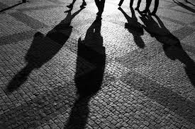
‘Out, out, brief _________! Life’s but a walking _____________’

Slide 19
‘I have supped full of h__________’
‘S_________thoughts’

