Slide 1
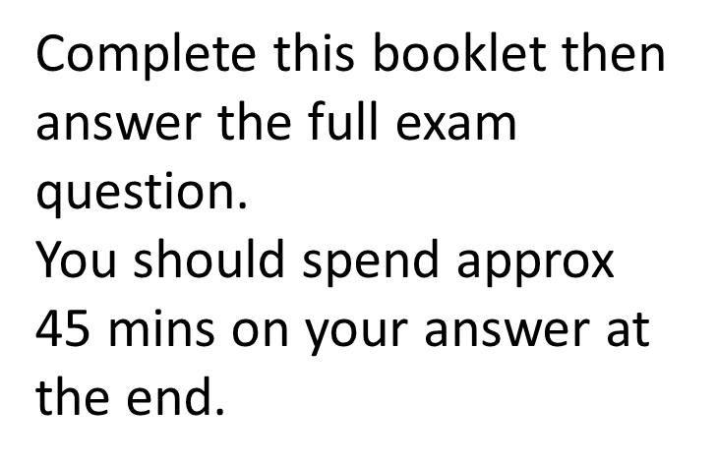
Literature Preparation Pack
Paper 1 – 1 hr 45 mins = 40%
Section A – Macbeth – 50 mins
Section B – A Sign of Four – 50 mins
Macbeth

Slide 2
Your question
What is the key words from the question?
Underline these.
Starting with this extract, explore how Shakespeare presents loyalty.
Write about
How Shakespeare presents loyalty in this extract
How Shakespeare presents loyalty in the play as a whole

Slide 3
What do you already know about loyalty ?
Fill in characters names at the top – what was motivating or driving them throughout the novel?
Read through the extract on next page – you will need to find evidence to back up what you already know!

Slide 4
This extract takes place after everyone discovers Duncan has been killed

Slide 5
Placing the extract in the play
Why did Macbeth kill the King?
____________________________________
Who was the key character who persuaded him to do this?
___________________________________
Who else was with Macbeth and was given predictions from the witches?
_____________________________________
Did Macbeth have any doubts about his actions?
________________________________________

Slide 6
Quick fire questions on extract
These will focus you on some of the key aspects!
Why does Macbeth say he killed the guards?
__________________________________________________________________________
Why do we know he actually killed the guards?
__________________________________________________________________________
What does he mean he was unable to do with his emotions in the rhetorical questions?
__________________________________________________________________________
How does he describe Duncan?
__________________________________________________________________________
What does he say again at the end of his speech?
__________________________________________________________________________
What does Lady Macbeth do + why?
__________________________________________________________________________
How does Macduff respond to this?
__________________________________________________________________________

Slide 7
Linking To Loyalty – Macbeth
How do we see a contrast between what Macbeth says and what he has done in the first line?
____________________________________________________
Why is it ironic that Macbeth lists positive adjectives?______________________________________________
Look at the use of contrasts in these pairs – what pairing did Macbeth and the witches both use? _______________________________
What adjectives are used to describe Duncan? _______________
How does this link to the Divine Right of Kings? ______________
How is this also ironic?
__________________________________________________

Slide 8
Linking to Loyalty – Lady Macbeth
Who is she being loyal to by pretending to faint?
_____________________________________________
Why is this ironic? Will they continue to be loyal to eachother?
_____________________________________________
Why do people assume she has fainted?
_________________________________________________
Why is this ironic given her plan?
_________________________________________________

Slide 9
Linking to Loyalty – Macduff
Why is it significant that Macduff is onstage here?
____________________________________
How does he act as a foil to Macbeth?
____________________________________
How do we see him represent loyalty throughout the play?
_______________________________________
Who else says they would not act on the predictions and remain loyal?
_______________________________________

Slide 10
Complete these quotes using words from side
Fair is foul and _________ is fair’
Stars, hide your _______, let not ________ see my black and _______ desires
look like th’innocent ________ but be the ________ under’t
keep my bosom franchised and ___________ clear
There’s __________ in men’s smiles
make our faces __________ to our __________
Serpent
Foul
Light
Flower
Fires
Allegiance
Daggers
Vizards
Deep
Hearts

Slide 11
This extract takes place after everyone discovers Duncan has been killed

Slide 12
Structure
Intro – what is his attitude here? How has this changed from start?
Quote 1 – explain. Link this to somewhere else
Quote 2 – explain. Link this to somewhere else
Quote 3 – explain. Link this to somewhere else
Quote 4 – explain. Link this to somewhere else
Quote 5 – explain. Link this to somewhere else
Add in the depth about THAT quote.
Explain in lots of detail.
Then briefly link this to somewhere else.
The focus HAS to be on the extract.

Slide 13
Getting started
Methods
Contrast
Adjectives
Rhetorical questions
Metaphors
Lists
Exclamation marks
Each para plan
- Quote from extract
- Explain this
- Link to somewhere else
- What show about society if can
- Link back to what learn
Shakespeare presents …………
We can see this in ……………………..
Shakespeare has used ……………………………….
This conveys …………………….
This demonstrates …………………
From this we learn ……………
We also saw ……………… when ………
Shakespeare also showed ……… when ……..
This shows us that in the Jacobean era ……….
From this we can learn that the Jacobean society ……….
We can see that ………….
Move through the previous para points

Slide 14
Before you finish
Make sure EVERY time you use a character’s name it has a capital letter.
Check that you have quotes from extract.
Have you looked at rest of play?
Have you said what we learn?
Are you saying what Shakespeare does?
Each paragraph needs to have a clear opening + closing line

