Slide 1


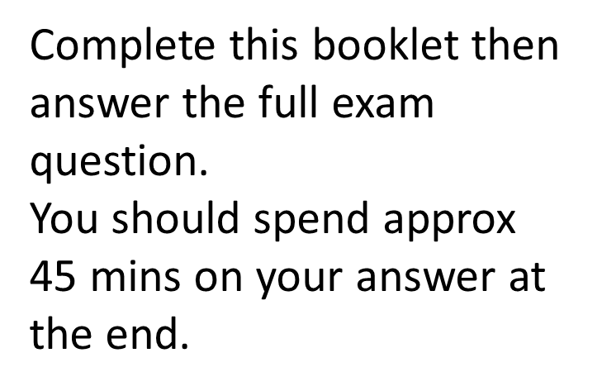
Literature Preparation Pack
Paper 2 – 2 hr 15 mins = 60%
Section A – An Inspector Calls = 45 mins
Section B – Poetry Anthology – Love and Relationships – 45 mins
Section C – Unseen Poetry – 45 mins
Unseen Poetry

Slide 2
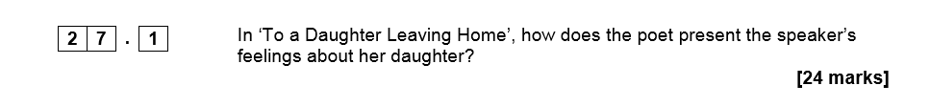
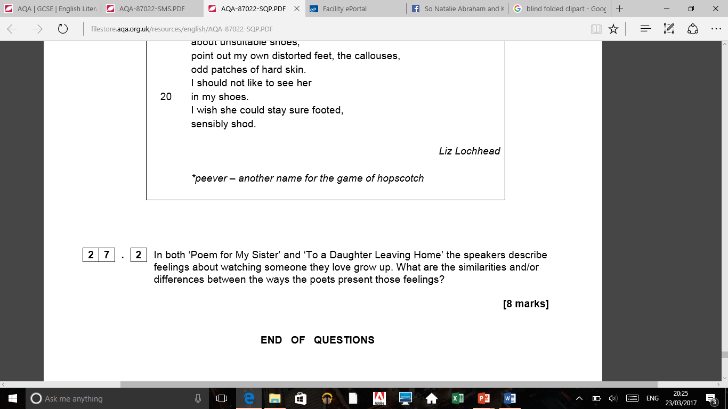
Questions first
Remember look at these before you read the poems.

Slide 3
Reading the questions first
What is the steer in Question 1?
_________________________________
What is the steer in Question 2?
_________________________________
What do we already know about the poems now before we start to read them?
__________________________________________________________________________________________________________________________

Slide 4
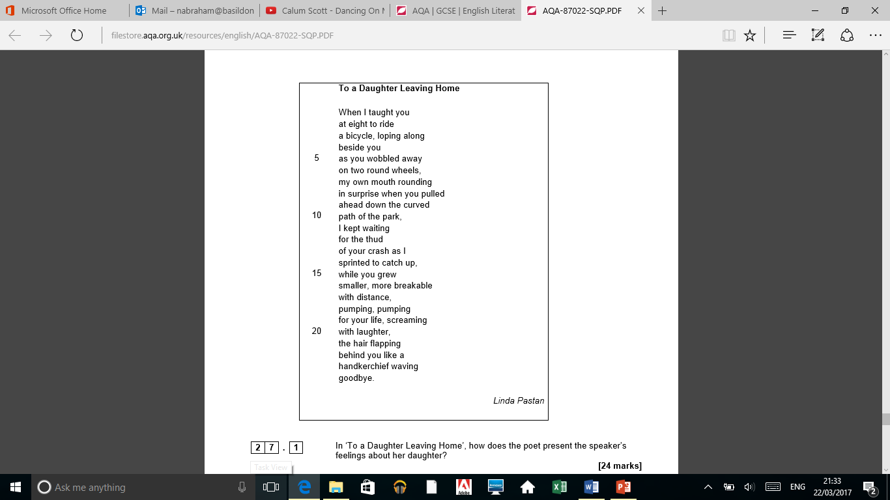
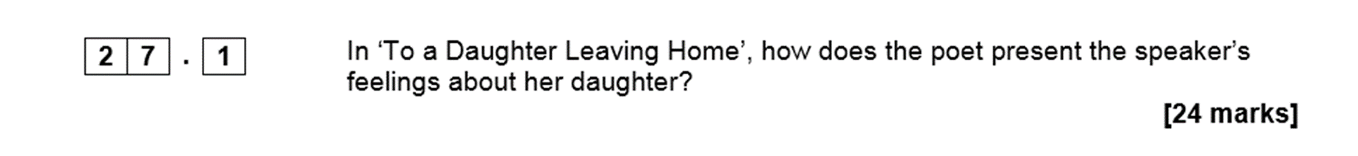
Poem 1 – question 1
JUST ON THIS POEM
You will be spending 30 mins on this

Slide 5
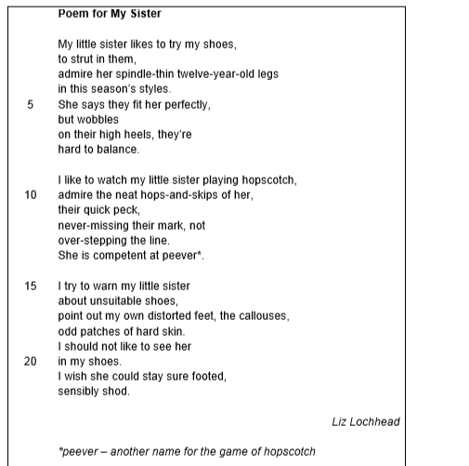
Poem 2 – question 2
BOTH poems
You will be spending 15 mins on this

Slide 6
Poem 1 – Answer these questions to get you started
Do you think the poet is JUST thinking about teaching her child to ride a bike? _________________
What could this also represent or be a metaphor for her daughter doing?
_________________________________________________
Which words show struggle at start? __________________
What could the child cycling away show? ___________________
How did this make the parent feel? _________________________
How is the daughter portrayed at the end? __________________
What could this show or represent? ______________________________

Slide 7
Poem 1 – Top quotes
What are your top quotes to use?
____________________________________
_____________________________________
_____________________________________
_____________________________________
_____________________________________
_____________________________________

Slide 8
Poem 1 structure points
What could the daughter on the bike represent?
_____________________________________________
What does the last word show?
_____________________________________________
What tense is it written in? What could this show?
_____________________________________________
Why do you feel there is enjambment used – what could it show about their relationship?
________________________________________________
Why do you think there is not a rhyme scheme used?
_________________________________________________

Slide 9
Poem 2 – Points to get you started
What adjective is used to describe the sister?
_________________________
Why do you think she is trying on the high heels?
_________________________________________
What does she do in them?
________________________________________
What could the shoes be a metaphor for in this poem?
_________________________________________
Is she just warning her about shoes at the end or does this have a deeper meaning?
_______________________________________________

Slide 10
Poem 2 – Top quotes
What are your top quotes to use?
____________________________________
_____________________________________
_____________________________________
_____________________________________
_____________________________________
_____________________________________

Slide 11
Poem 2 – Structure points
How does the poet use stanzas to show time passing?
___________________________________________
Why do you think enjambment is used again?
___________________________________________
What tense is this poem in?
____________________________________________

Slide 12
Bringing both poems together
How are both about a similar theme?
__________________________________________________
How do they use objects?
What are they showing?
___________________________________________________
How do we see both loved ones shown in an innocent way?
__________________________________________________
How do we see a sense of protection in both?
___________________________________________________
How do both feel watching the other grow up?
____________________________________________________

Slide 13
Question 1 plan – JUST poem 1 – 30 mins
Intro – sum up what her feelings are
Structure – what + why is this important
Quote / method / what it shows
Quote / method / what it shows
Quote / method / what it shows
Quote / method / what it shows
Quote / method / what it shows
This shouldn’t take any more than 8 mins
You should spend at least 20 mins on this.
The more on language, the better!

Slide 14
Question 2 plan – BOTH poems – 15 mins
Intro – sum up what both feelings are
Structure – what + why is this important
Quote A / method / what it shows
Quote B/ method / what it shows
Quote A/ method / what it shows
Quote B/ method / what it shows
Quote A/ method / what it shows
Quote B/ method / what it shows
This shouldn’t take any more than 5 mins
You should spend at least 10 mins on this.
The more on language, the better!

Slide 15
Sentence starters
This shows ……………
From this we can see ……………………………..
This conveys ……………………………………
……………………………….. which portrays…….
We can learn that ……….
This might suggest ……………….
This could mean …………………………
You MUST use a new sentence if starting with THIS.
‘which’ is a connective!

