Slide 2
Key quotes for ‘A Sign of Four’

Slide 3
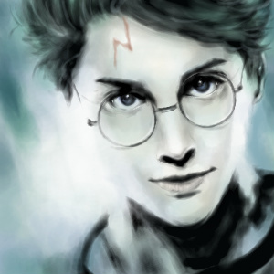
Sherlock
_______ with innumerable _________ marks

Slide 4
Sherlock
My ______ ________ at stagnation

Slide 5
Sherlock
I ab____ the ____ _______ of existence

Slide 6
Sherlock
The _____ __________ consulting detective

Slide 7
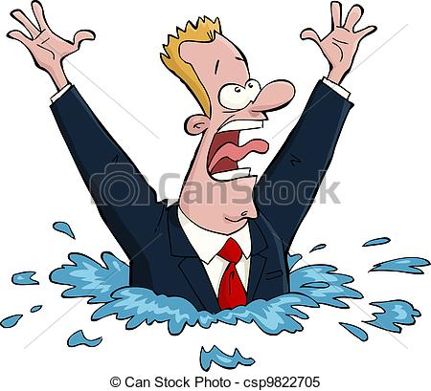
Sherlock on Jones
Jones, out of his _________, which is his n________ state

Slide 8
Sherlock
The w_______ itself …………………. is my highest r____________.

Slide 9
My n_________ features in no ________________

Slide 10
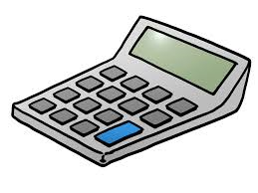
Watson on Sherlock
a cal_______-m_______
In________

Slide 11
Descriptions of London
Alliteration + pathetic fallacy + personification
Dense dr______ fog lay l______ upon the great city

Slide 12
Sholtos
The c__________ greed
We had plenty of ___________ ourselves. I d________ no more
he was av___________ to part with them

Slide 13
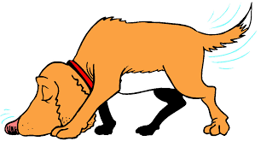
Sherlock + The Baker Street Irregulars
Like those of a trained ___________
Eyes gleaming … like those of a _______
The un__________l force
They can ____ everywhere, _____ everything, __________ everyone

Slide 14
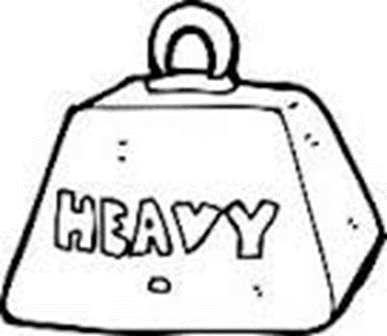
View on Mary – Watson
What an ______________ woman
h_______ turned as heavy as l______
Treasure a ‘b__________’
Instinct to com_______ + pr__________
an_______ fashion

Slide 15
View on Mary – Sherlock
A client is to me a mere _______
Women are never to be entirely ______________
E_________ is opp________ to true c_______ r_________

Slide 16
Jones
Sound repeated – l________
No room for th_________
That’s c_________ s________
Ho______ po_____

