Slide 1
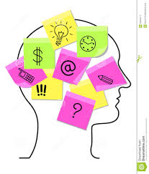
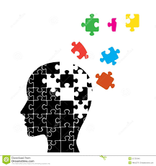

Knowing our
Quotes
An Inspector Calls

Slide 2

Crofts and Birlings – working together for lower costs and higher prices

Slide 3

A man has to make his own way

Slide 4

Community and all that nonsense

Slide 5
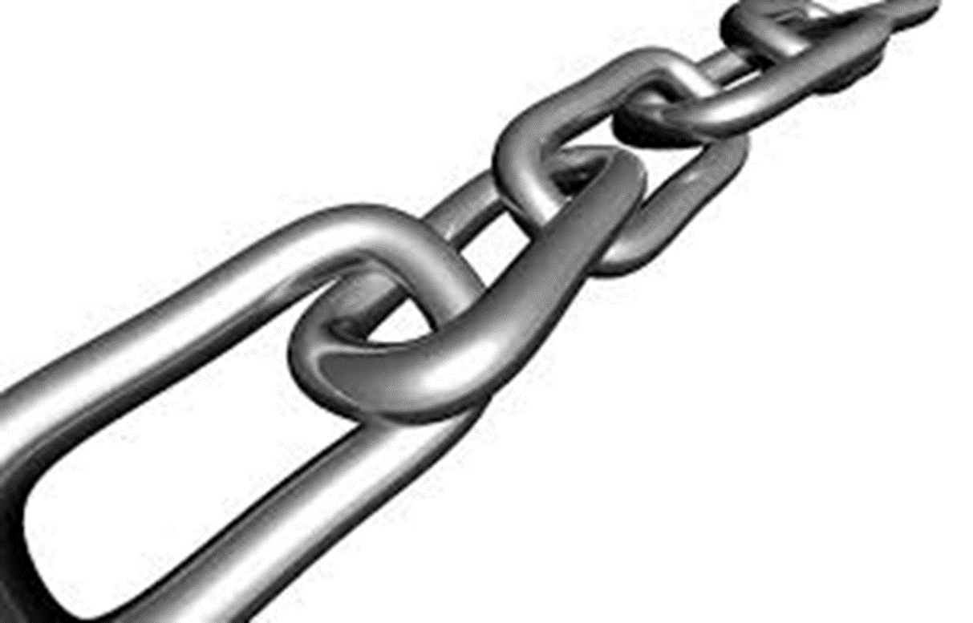
A chain of events

Slide 6

My God!
How horrible!

Slide 7

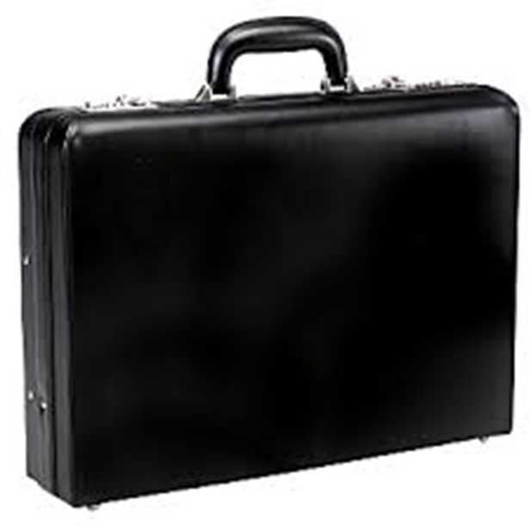
A hard headed, practical man of business

Slide 8

Why shouldn’t they try for higher wages?

Slide 9

These girls aren’t cheap labour – they’re people.

Slide 10

You abused the power you had

Slide 11
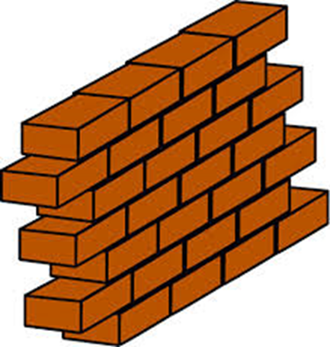
You mustn’t try to build up a kind of wall between us and that girl

Slide 12
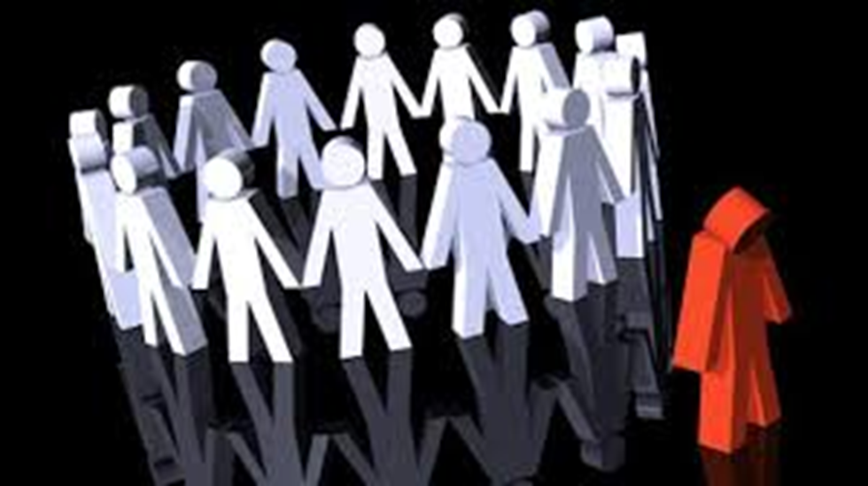
Prejudiced against her case

Slide 13

As if a girl of that sort would ever refuse money

Slide 14


I know I’m to blame and I’m desperately sorry

Slide 15
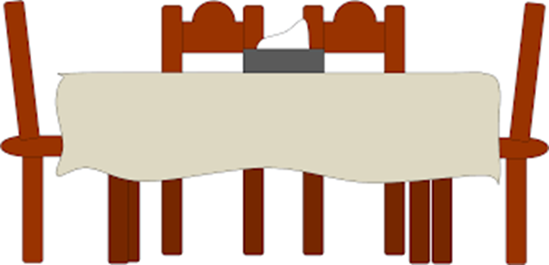
You and I aren’t the same people who sat down for dinner here

Slide 16

Public men have responsibilities as well as privileges

Slide 17
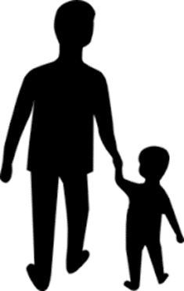
You’re not the kind of father a chap could go to when he’s in trouble

Slide 18

I’m not likely to forget

Slide 19

You killed her – damn you, damn you

Slide 20
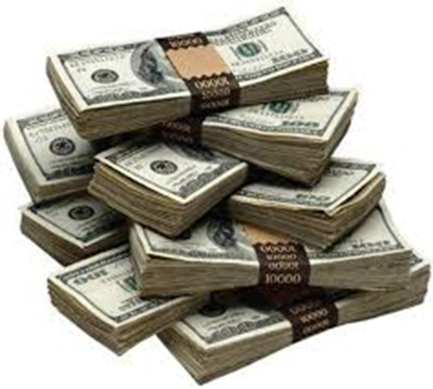
I’d give thousands

Slide 21

There’s every excuse for what your mother and I did

Slide 22

We’ve been had
Hoax

Slide 23

I suppose we’re all nice people now

Slide 24
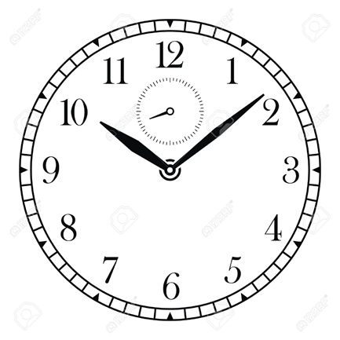

It’s too soon

Slide 25
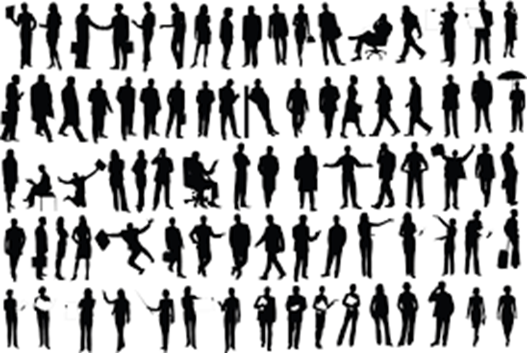
There are millions and millions and millions of Eva Smiths and John Smiths still left with us

Slide 26

We don’t live alone.
We are members of one body.
We are responsible for each other.

Slide 27



If men will not learn this lesson, they will be taught it in fire and blood and anguish

Slide 28
Crofts and Birlings – _________ for lower _______ and higher ______

Slide 29
A man has to _____ his ________

Slide 30
Com_____ and all that n_______

Slide 31
A chain of ________

Slide 32
My ____!
How _______!

Slide 33
A hard ________, practical man of _______

Slide 34
Why shouldn’t they try for _________?

Slide 35
These ______ aren’t ________ – they’re _______.

Slide 36
You _______ the _____ you had

Slide 37
You mustn’t try to build up a ________ between ____________

Slide 38
________ against her case

Slide 39
As if a _____of that ______ would ever _________

Slide 40
I know I’m to ______ and I’m _________

Slide 41
You and I aren’t the ________ who _______ for dinner here

Slide 42
______ men have _______ as well as _______

Slide 43
You’re not the kind _______ a ______ could go to when __________

Slide 44
I’m not likely to ________

Slide 45
You ______ her – _____ you, _____ you

Slide 46
I’d give ________

Slide 47
There’s every ______ for what your _________

Slide 48
We’ve been ____
H____

Slide 49
I suppose we’re all ____________ now

Slide 50
It’s too ______

Slide 51
There are _______ and _______ and _______ of __________________________ still left with us

Slide 52
We don’t _____ alone.
We are ______ of one _____.
We are ________for each other.

Slide 53
If men will not learn this ______, they will be taught it in ____ and _____ and _____

